Slide 1








MY DEAR GREAT TEACHER
My Journal to Python
蘇伊凡 4110E223

Slide 2

AGENDA
Python
Input and output: input() and print()
Data types: numerisc, strings, list , dict
Operators ON data type:
CONTROLS: IF- | IF –ELSIF|-F-ELSE
LOOP: FOR | WHILE | RANGE() | BREAK | CONTINUE
FUNCTION:
PARAMETERS(ARGUMENTS)
RECURSIVE FUNCTION
LAMBDA FUNCTION

Slide 3







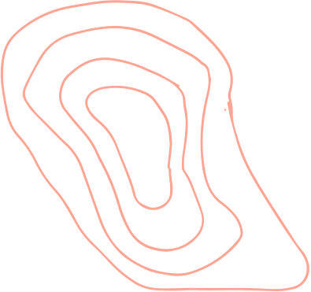
Python
Python is a very popular general-purpose interpreted, interactive, object-oriented, and high-level programming language.
Python is a dynamically-typed and garbage-collected programming language. It was created by Guido van Rossum during 1985- 1990.

Slide 4


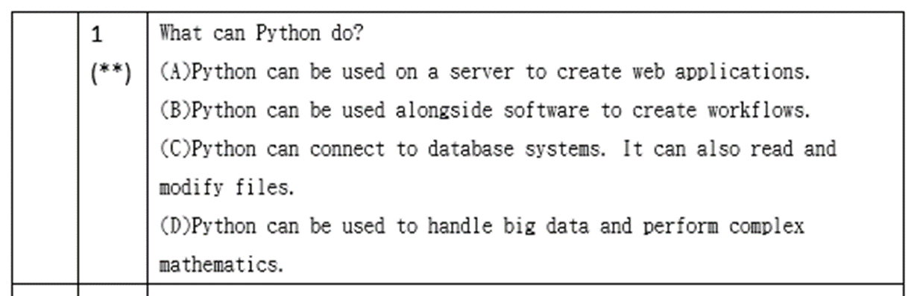

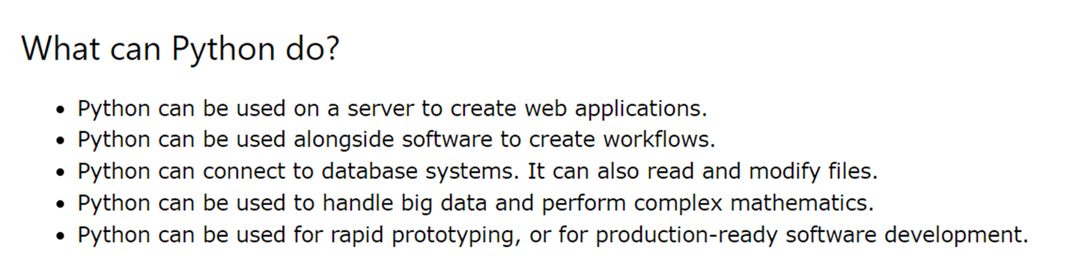


PYTHON

Slide 5

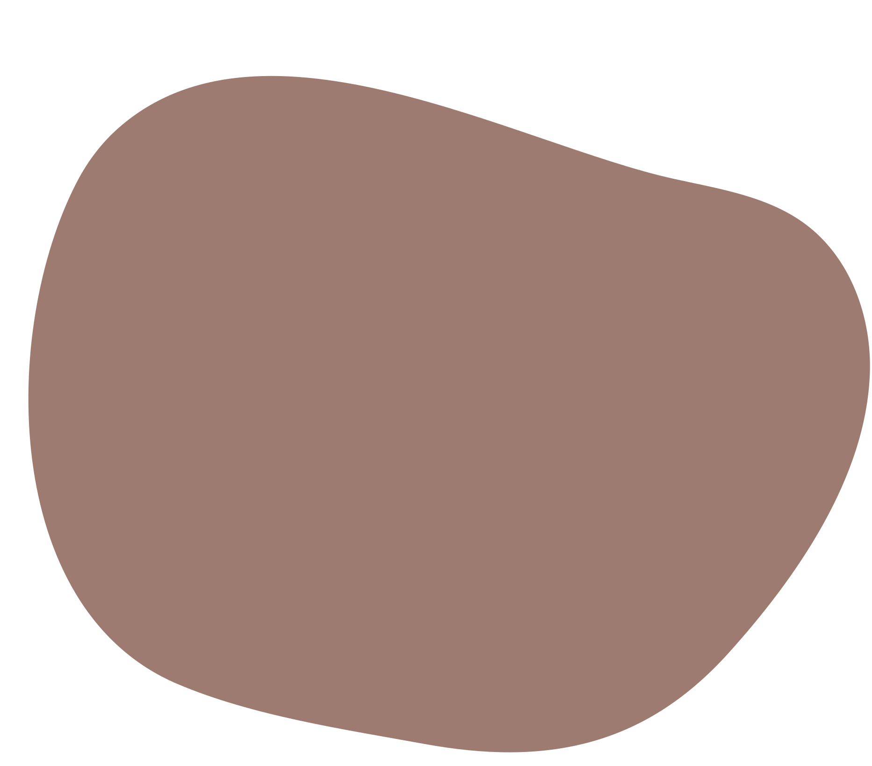





Data types: Dictionary
Dictionaries are used to store data values in key:value pairs.
A dictionary is a collection which is ordered*. changeable and do not allow duplicates.
As of Python version 3.7, dictionaries are ordered.
In Python 3.6 and earlier, dictionaries are unordered.
Dictionaries are written with curly brackets
,and have keys and values:

Slide 6

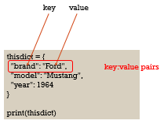
Data types: Dictionary

Slide 7
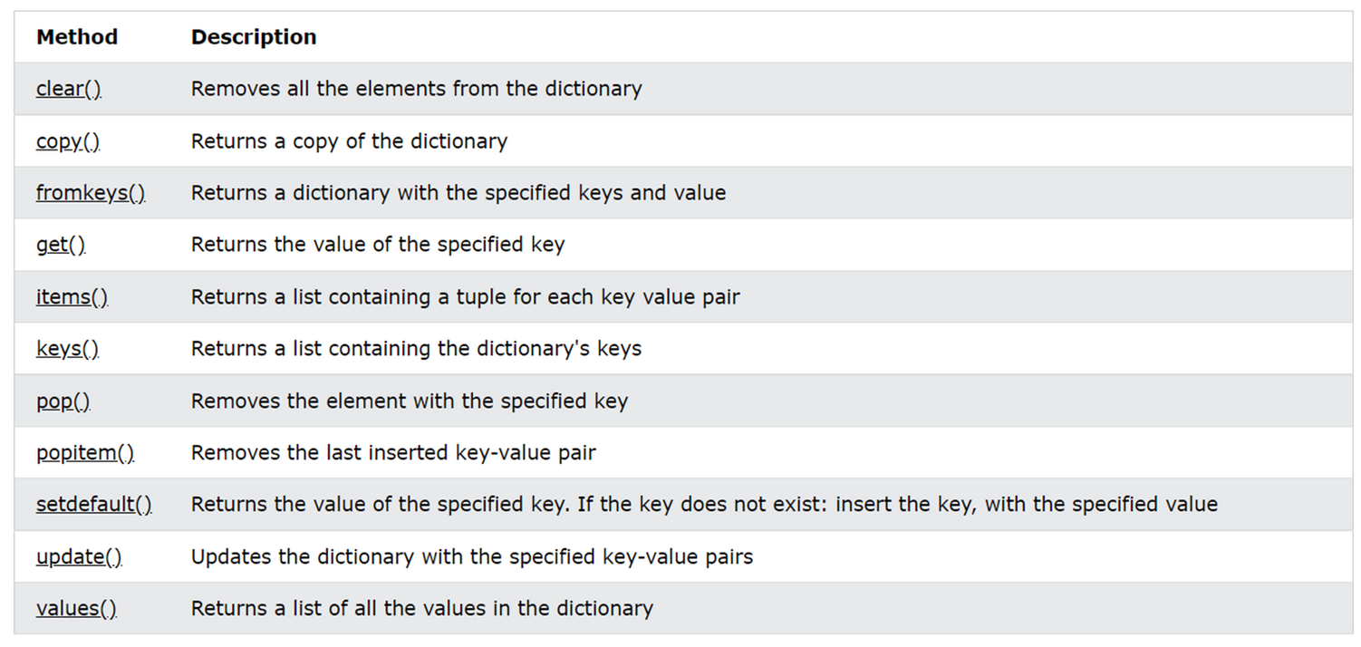
Dictionary Methods

Slide 8
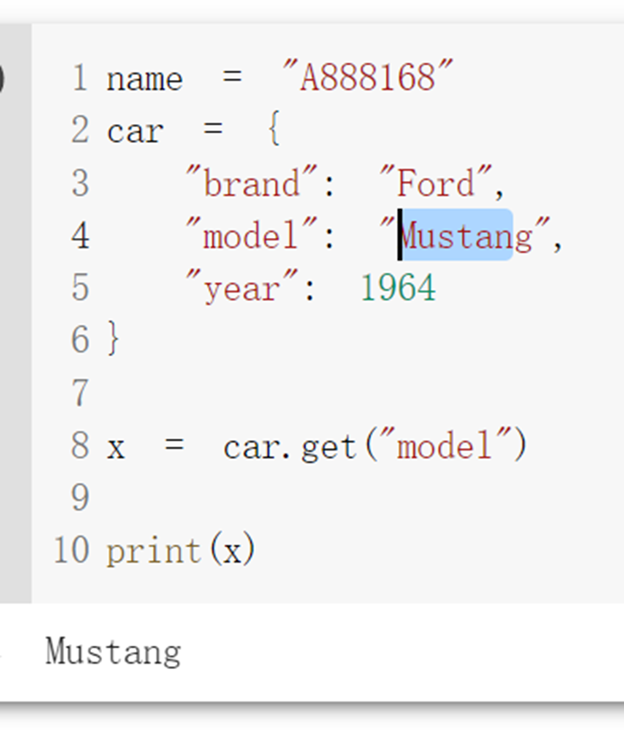


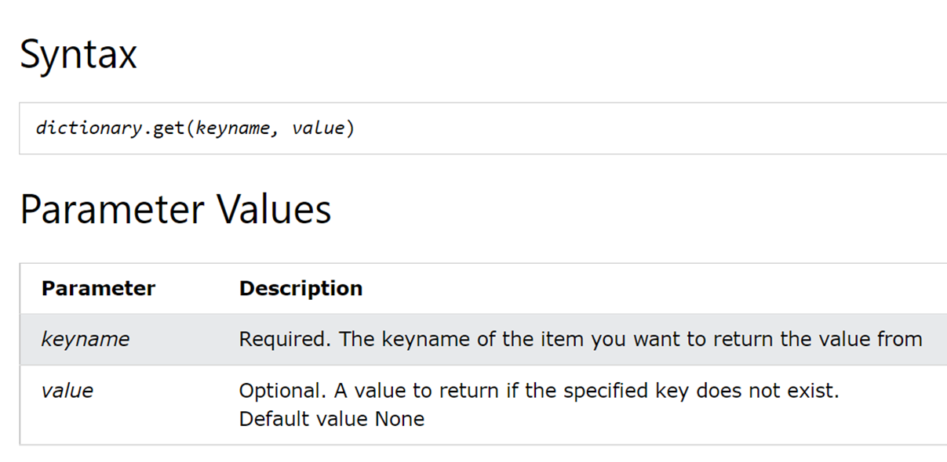

get()

Slide 9



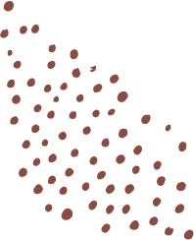
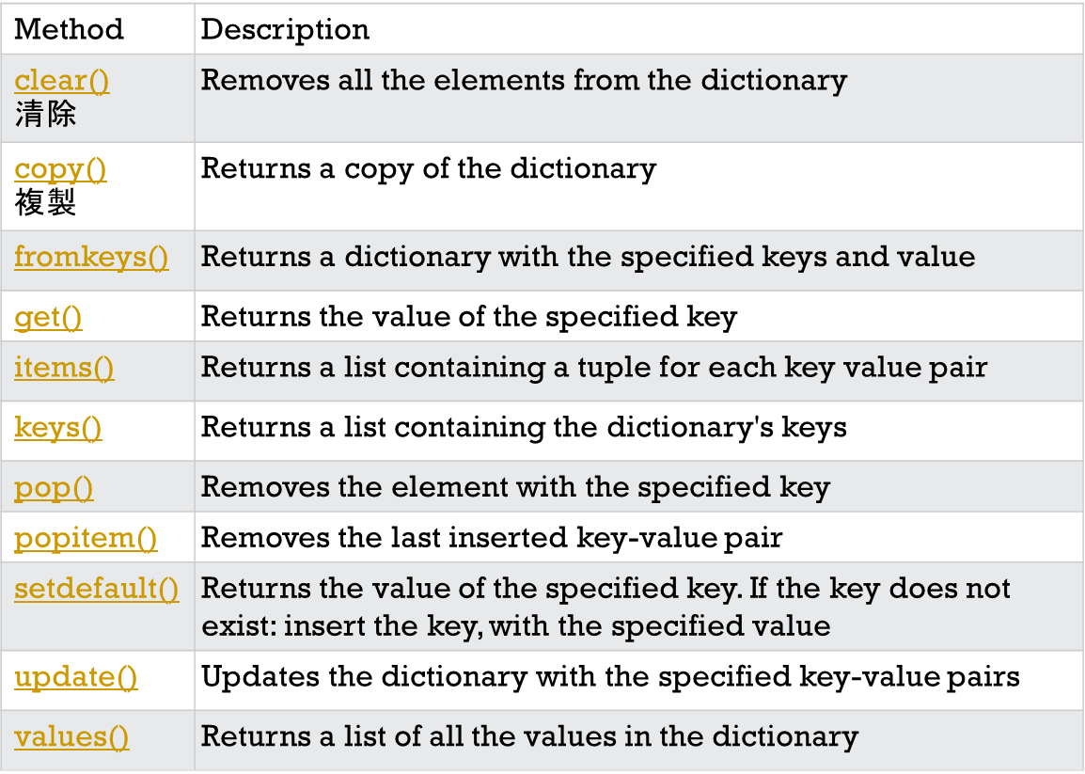
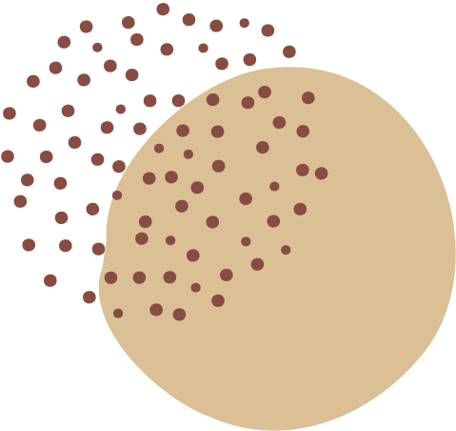



Slide 10



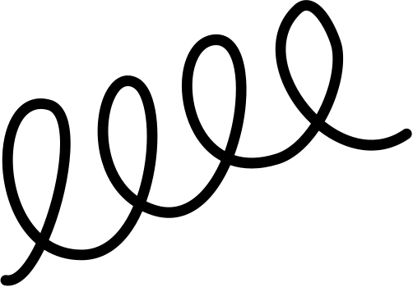

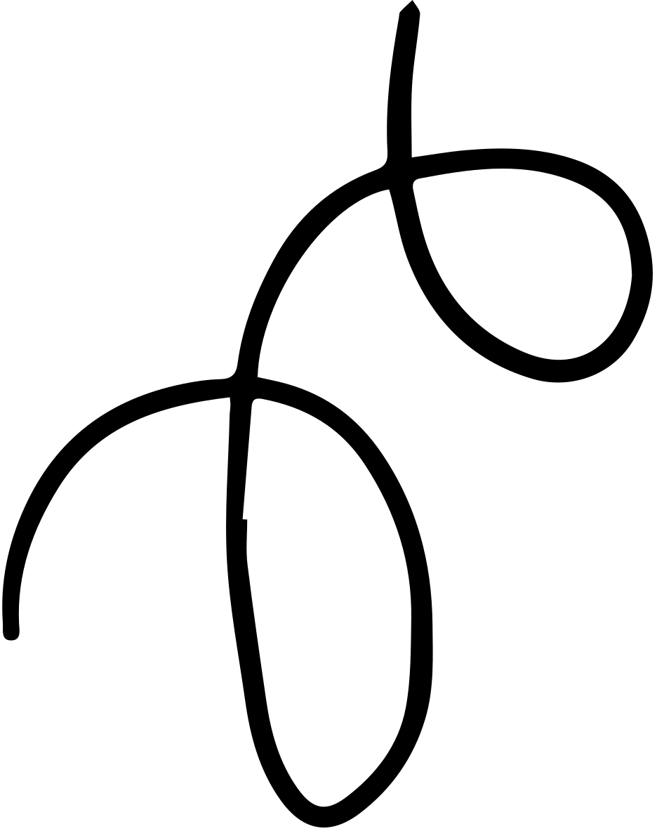
PYTHON

Slide 11

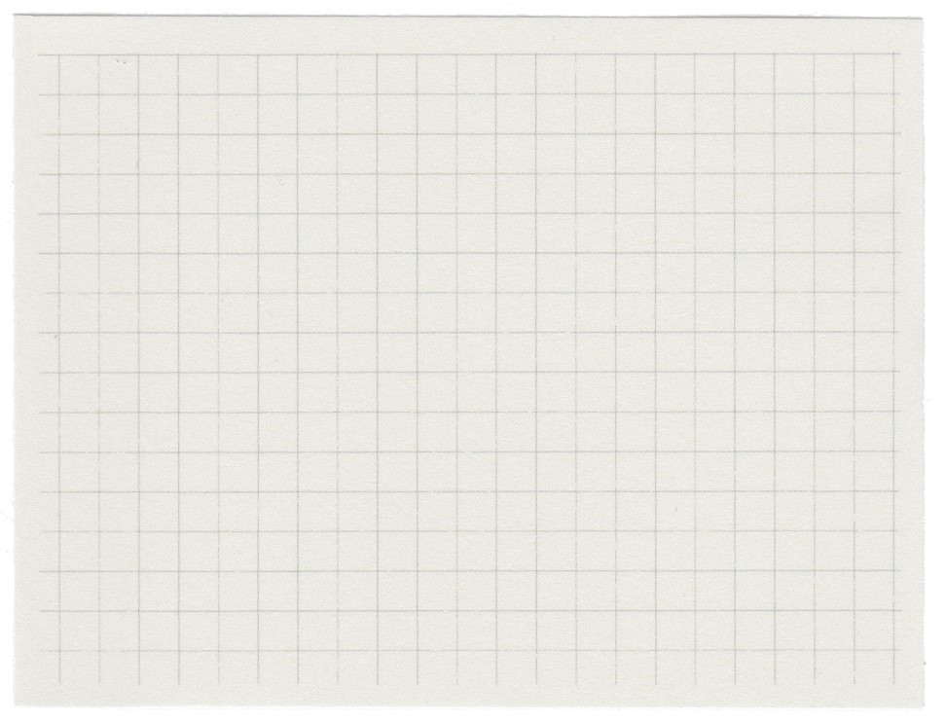

WHAT IS PYTHON
•Python is a high-level, object-oriented programming language with built-in data structures and dynamic semantics. It supports multiple programming paradigms, such as structures, object-oriented, and functional programming.
•Python supports different modules and packages, which allows program modularity and code reuse.

Slide 12

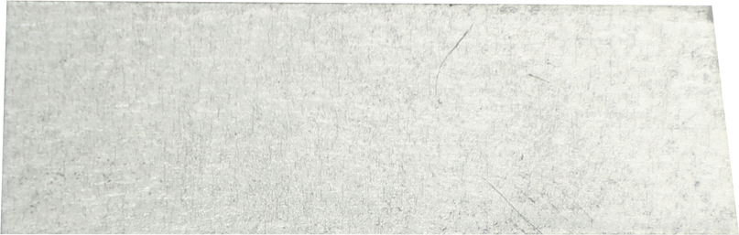
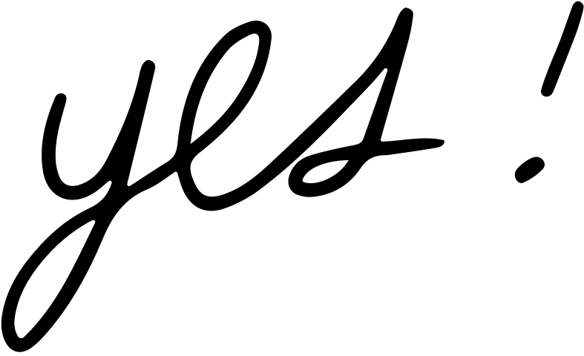
Python Jobs
•Career Opportunities
-Python language provides several job opportunities and promises high growth with huge salary prospects.

Slide 13

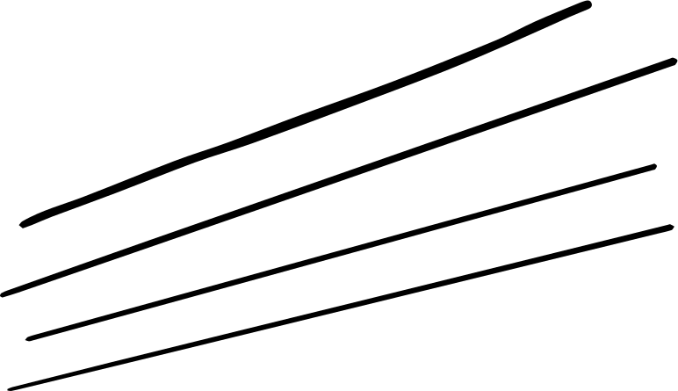
WHY TO LEARN PYTHON?
Python is a very popular programming language today and often needs an introduction. It is widely used in various business sectors, such as programming, web development, machine learning, and data science. Given its widespread use, it’s not surprising that Python has surpassed Java as the top programming language.
The Top 10 Reasons
1.Career Opportunities and Salary 6. Libraries and Packages
2.Data Science 7. Testing Frameworks
3.Machine Learning 8. Portable and Extensible
4.Web Development 9. Active Community
5.Scripting and Automation 10. Easy to Use

Slide 14




WHY DO WE NEED TO LEARN PYTHON
Often, programmers fall in love with Python because of the increased productivity it provides. Since there is no compilation step, the edit-test-debug cycle is incredibly fast. Debugging Python programs is easy: a bug or bad input will never cause a segmentation fault. Instead, when the interpreter discovers an error, it raises an exception. When the program doesn't catch the exception, the interpreter prints a stack trace. A source level debugger allows inspection of local and global variables, evaluation of arbitrary expressions, setting breakpoints, stepping through the code a line at a time, and so on.
The debugger is written in Python itself, testifying to Python's introspective power. On the other hand, often the quickest way to debug a program is to add a few print statements to the source: the fast edit-test-debug cycle makes this simple approach very effective.

Slide 15
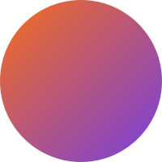

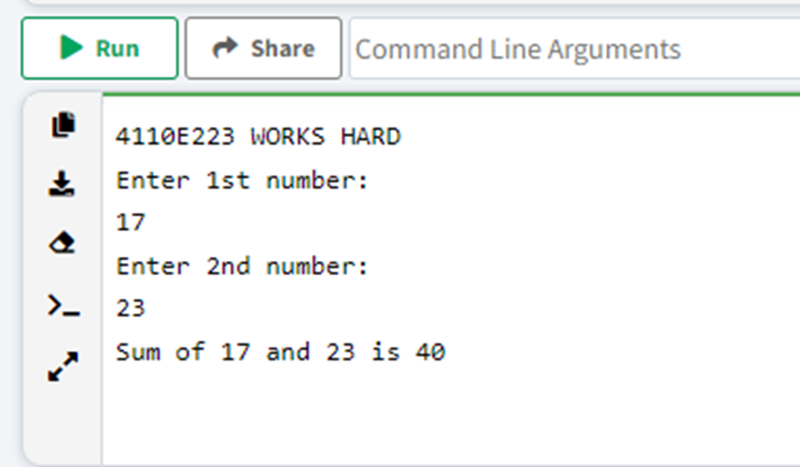
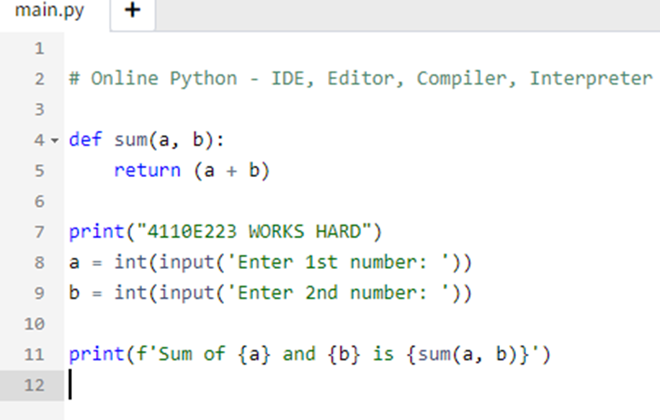
Python Online
Interpreter: 1

Slide 16

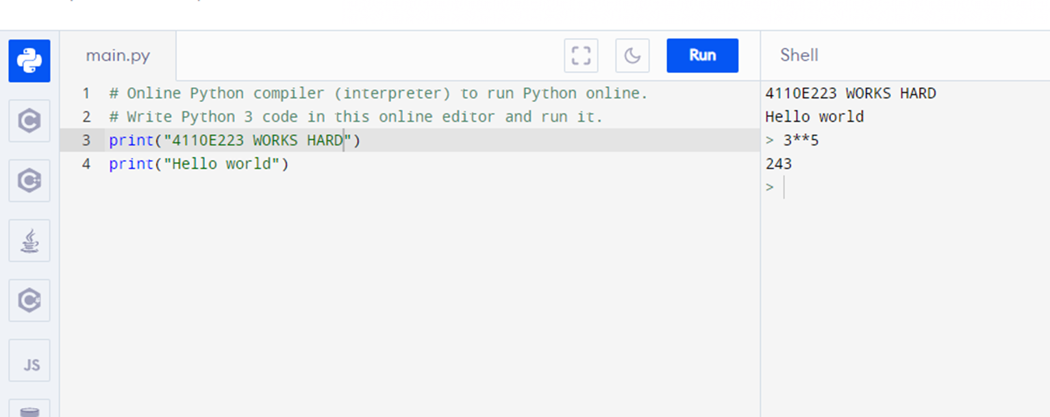
PYTHON ONLINEINTERPRETER: 2

Slide 17


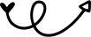
INPUT AND OUTPUT

Slide 18
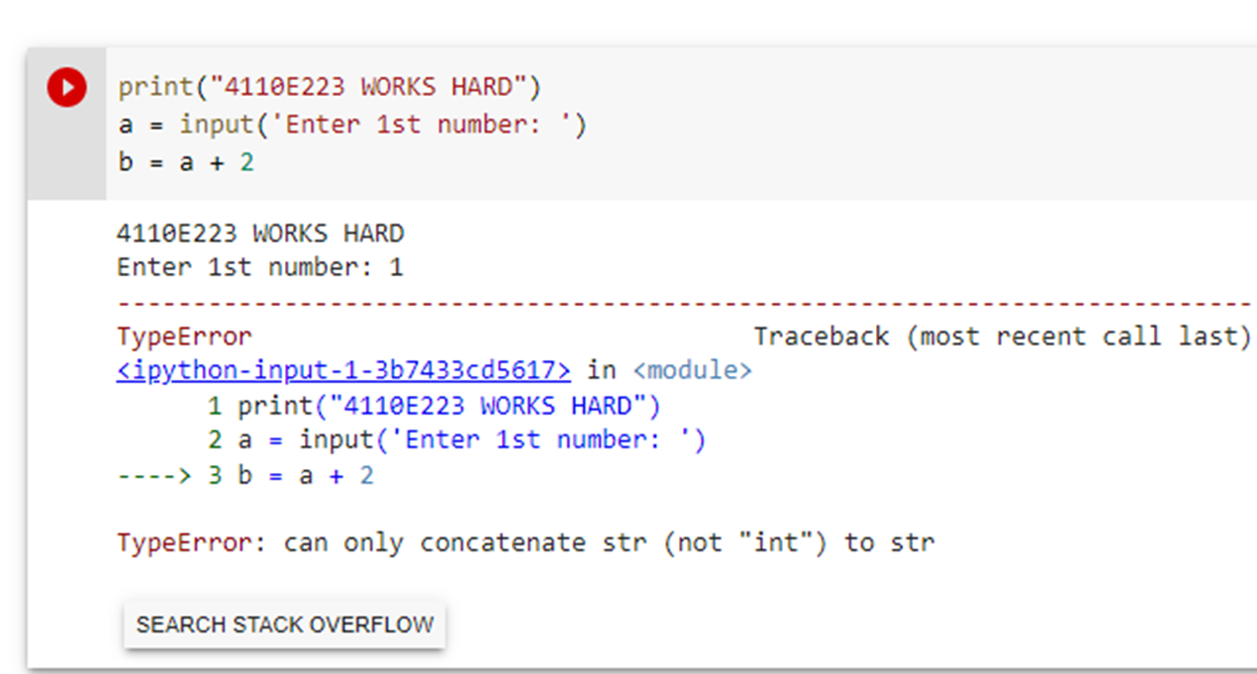
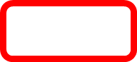
QUESTION:
DATA TYPE

Slide 19


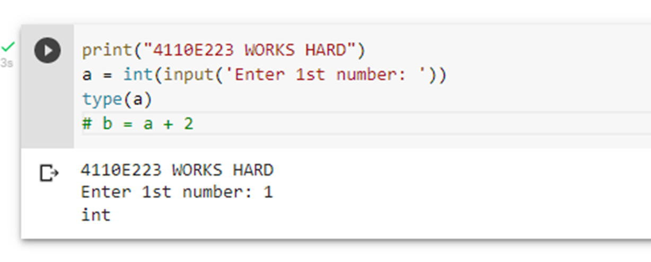
WAY: 1

Slide 20
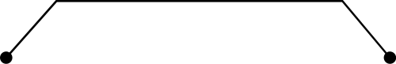
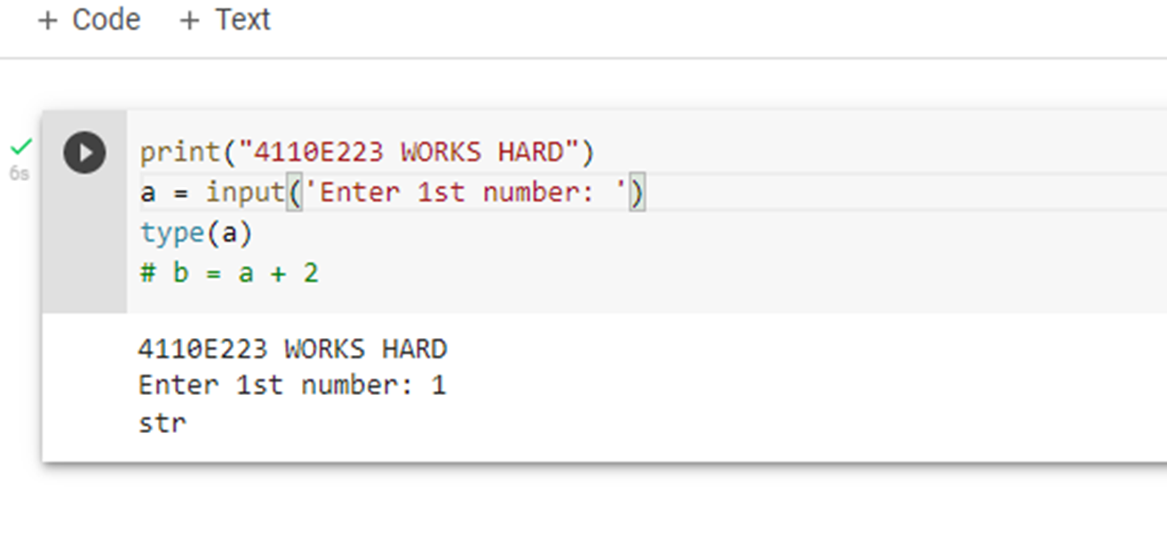
WAY: 2

Slide 21



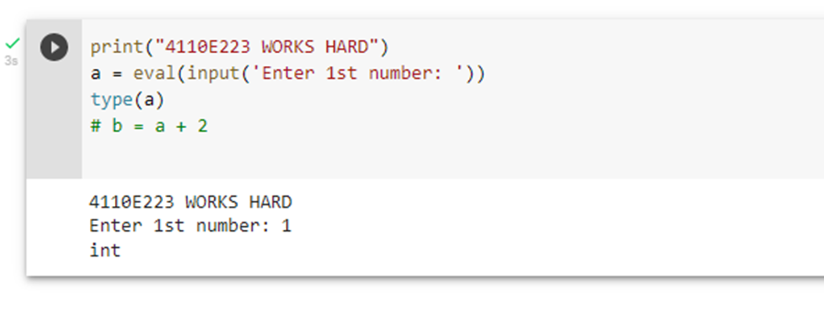
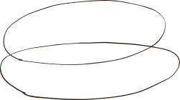

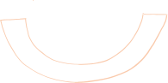
WAY: 3

Slide 22


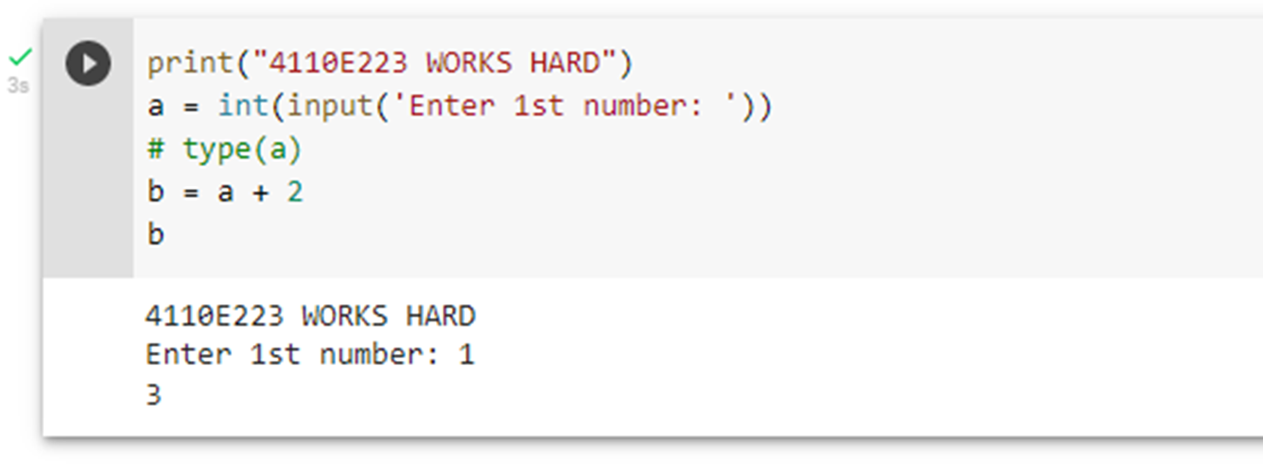
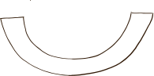
ANSWER: 1

Slide 23


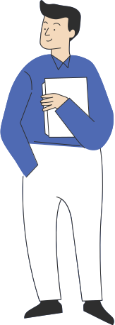
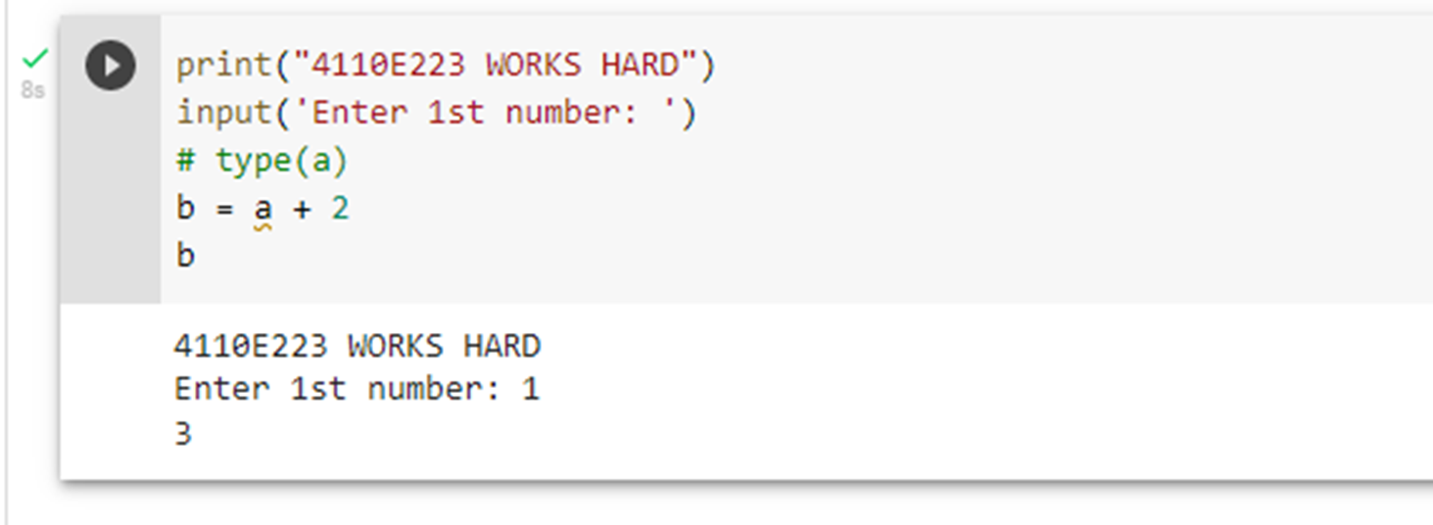

ANSWER: 2

Slide 24

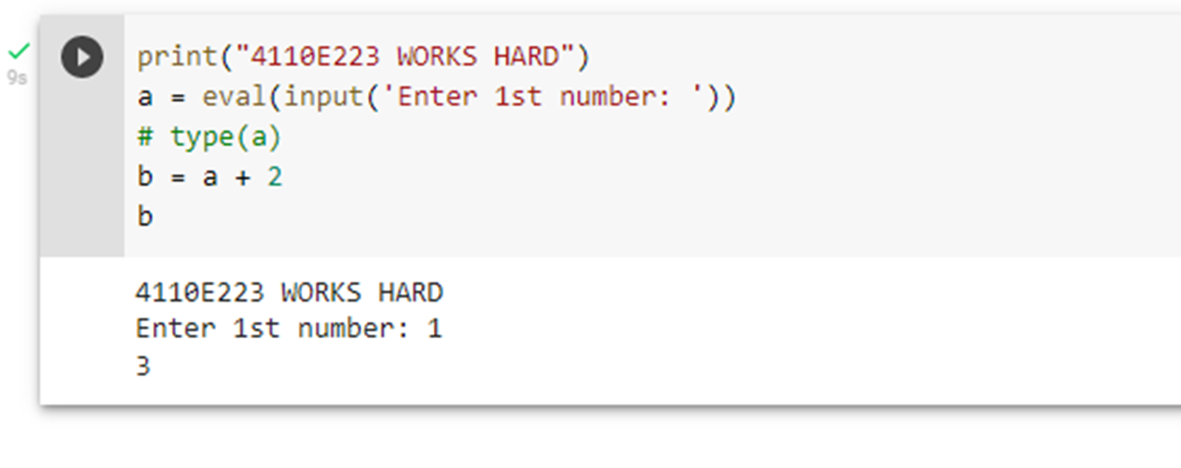
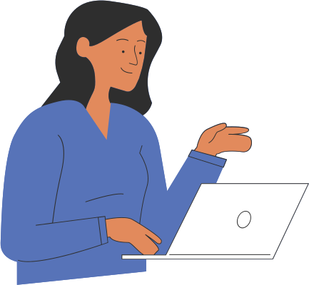
ANSWER: 3

Slide 25
DATA TYPES

Slide 26
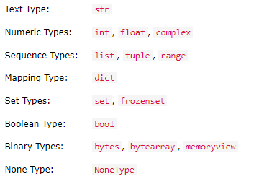
Built-in Data Types
In programming, data type is an important concept. Variables can store data of different types, and different types can do different things. Python has the following data types built-in by default, in these categories:

Slide 27
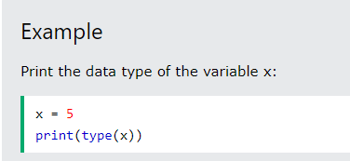
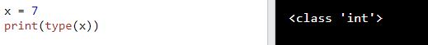
GETTING THE DATA TYPE
You can get the data type of any object by using the type() function:

Slide 28
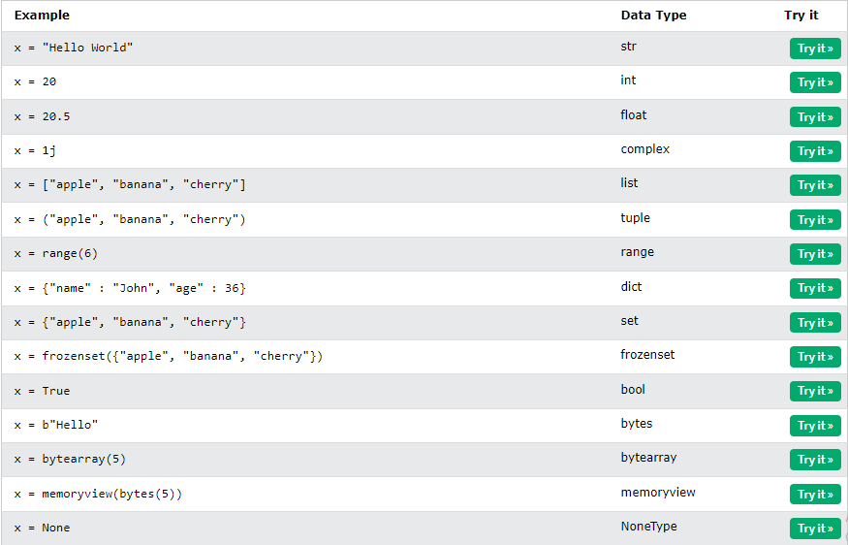
SETTING THE DATA TYPE
In Python, the data type is set when you assign a value to a variable:

Slide 29
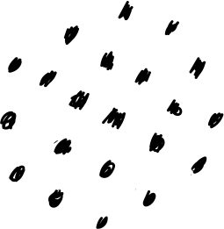

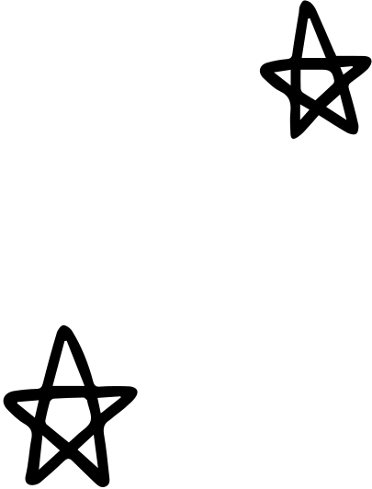
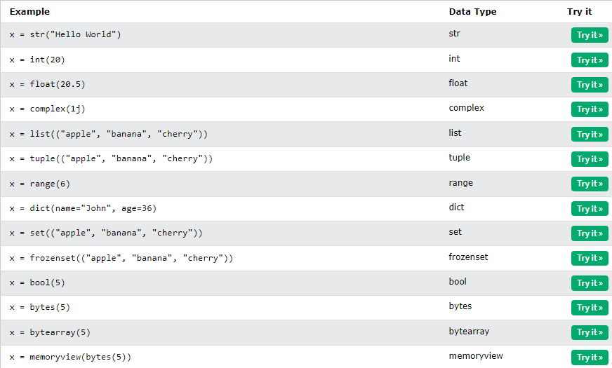
SETTING THE SPECIFIC DATA TYPE
If you want to specify the data type, you can use the following constructor functions:

Slide 30
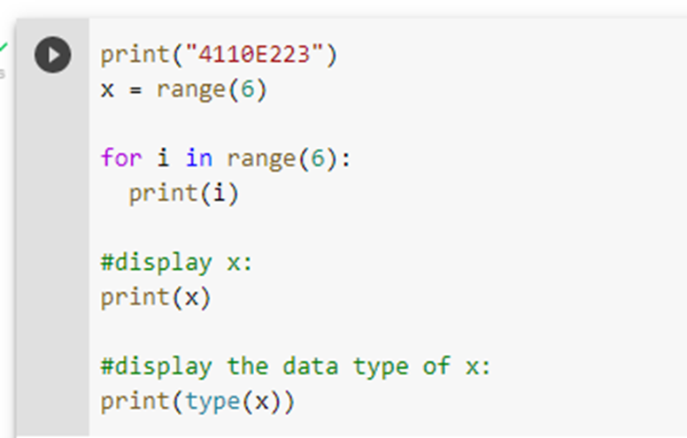

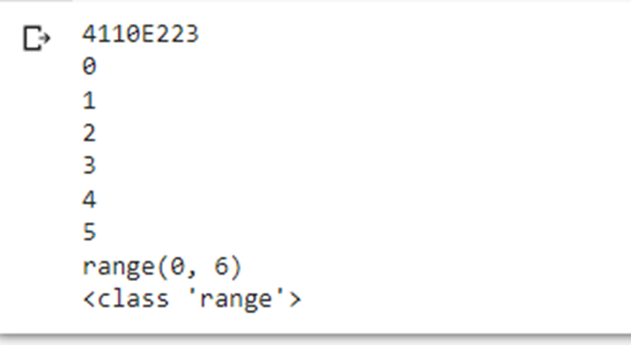

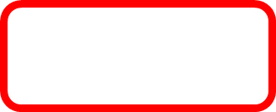

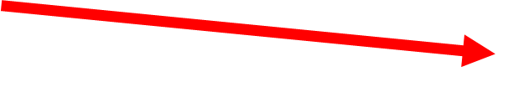
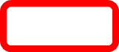

PYTHON DATA

Slide 31




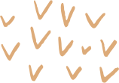
Python Numbers

Slide 32
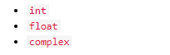


Python Numbers
There are three numeric types in Python:
Variables of numeric types are created when you assign a value to them:
To verify the type of any object in Python, use the type() function:

Slide 33

Int
Int, or integer, is a whole number, positive or negative, without decimals, of unlimited length.

Slide 34





FLOAT
Float, or "floating point number" is a number, positive or negative, containing one or more decimals.
Float can also be scientific numbers with an "e" to indicate the power of 10.

Slide 35

Complex
Complex numbers are written with a "j" as the imaginary part:

Slide 36

Type Conversion
You can convert from one type to another with the int(), float(), and complex() methods:

Slide 37
Random Number
Python does not have a random() function to make a random number, but Python has a built-in module called random that can be used to make random numbers:

Slide 38

Python Strings

Slide 39



Strings
You can display a string literal with the print() function:

Slide 40
ASSIGN STRING TO A VARIABLE
Assigning a string to a variable is done with the variable name followed by an equal sign and the string:

Slide 41

MULTILINE STRINGS
You can assign a multiline string to a variable by using three quotes:
Or three single quotes:

Slide 42

Strings are Arrays
Like many other popular programming languages, strings in Python are arrays of bytes representing unicode characters.

Slide 43

Looping Through a String
Since strings are arrays, we can loop through the characters in a string, with a for loop.

Slide 44

String Length
To get the length of a string, use the len() function.

Slide 45






Check String
To check if a certain phrase or character is present in a string, we can use the keyword in.
•keyword in vs if
•True or False

Slide 46

DICT: KEY-VALUE PAIR

Slide 47
PYTHON OPERATORS

Slide 48

PYTHON OPERATORS
Operators are used to perform operations on variables and values.
In the example below, we use the + operator to add together two values:

Slide 49

Python Arithmetic Operators
Arithmetic operators are used with numeric values to perform common mathematical operations:

Slide 50


PYTHON ASSIGNMENT OPERATORS
Assignment operators are used to assign values to variables:

Slide 51



Python Comparison Operators
Comparison operators are used to compare two values:

Slide 52

Python Logical Operators
Logical operators are used to combine conditional statements:

Slide 53

Python Identity Operators
Identity operators are used to compare the objects, not if they are equal, but if they are actually the same object, with the same memory location:

Slide 54

Python Membership Operators
Membership operators are used to test if a sequence is presented in an object:

Slide 55

Python Bitwise Operators
Bitwise operators are used to compare (binary) numbers:

Slide 56
Python If ... Else

Slide 57

Python Conditions and If statements
Python supports the usual logical conditions from mathematics:
These conditions can be used in several ways, most commonly in "if statements" and loops.
An "if statement" is written by using the if keyword.

Slide 58

Python Conditions and If statements
In this example we use two variables, a and b, which are used as part of the if statement to test whether b is greater than a. As a is 33, and b is 200, we know that 200 is greater than 33, and so we print to screen that "b is greater than a".

Slide 59
Indentation
Python relies on indentation (whitespace at the beginning of a line) to define scope in the code. Other programming languages often use curly-brackets for this purpose.

Slide 60



Indentation

Slide 61

Elif
The elif keyword is pythons way of saying "if the previous conditions were not true, then try this condition".
In this example a is equal to b, so the first condition is not true, but the elif condition is true, so we print to screen that "a and b are equal".

Slide 62

Else
In this example a is greater than b, so the first condition is not true, also the elif condition is not true, so we go to the else condition and print to screen that "a is greater than b".
You can also have an else without the elif:

Slide 63

Else

Slide 64

Short Hand If
If you have only one statement to execute, you can put it on the same line as the if statement.

Slide 65


Short Hand If ... Else
If you have only one statement to execute, one for if, and one for else, you can put it all on the same line:

Slide 66

Short Hand If ... Else

Slide 67

And

Slide 68






Or
The or keyword is a logical operator, and is used to combine conditional statements:

Slide 69

NESTED IF
You can have if statements inside if statements, this is called nested if statements.

Slide 70

THE PASS STATEMENT
if statements cannot be empty, but if you for some reason have an if statement with no content, put in the pass statement to avoid getting an error.

Slide 71
Python For Loops

Slide 72
Python For Loops
A for loop is used for iterating over a sequence (that is either a list, a tuple, a dictionary, a set, or a string).
This is less like the for keyword in other programming languages, and works more like an iterator method as found in other object-orientated programming languages.
With the for loop we can execute a set of statements, once for each item in a list, tuple, set etc.

Slide 73

Python For Loops
The for loop does not require an indexing variable to set beforehand.

Slide 74

Looping Through a String
Even strings are iterable objects, they contain a sequence of characters:

Slide 75

The break Statement
With the break statement we can stop the loop before it has looped through all the items:
Exit the loop when x is "banana":

Slide 76

The break Statement
Exit the loop when x is "banana", but this time the break comes before the print:

Slide 77

The continue Statement
With the continue statement we can stop the current iteration of the loop, and continue with the next:

Slide 78

The range() Function
To loop through a set of code a specified number of times, we can use the range() function,
The range() function returns a sequence of numbers, starting from 0 by default, and increments by 1 (by default), and ends at a specified number.
Using the range() function:

Slide 79

The range() Function
Note that range(6) is not the values of 0 to 6, but the values 0 to 5.
The range() function defaults to 0 as a starting value, however it is possible to specify the starting value by adding a parameter: range(2, 6), which means values from 2 to 6 (but not including 6):
Using the start parameter:

Slide 80

The range() Function
The range() function defaults to increment the sequence by 1, however it is possible to specify the increment value by adding a third parameter: range(2, 30, 3):
Increment the sequence with 3 (default is 1):

Slide 81


Else in For Loop
The else keyword in a for loop specifies a block of code to be executed when the loop is finished:
Print all numbers from 0 to 5, and print a message when the loop has ended:

Slide 82

Nested Loops
A nested loop is a loop inside a loop.
The "inner loop" will be executed one time for each iteration of the "outer loop":

Slide 83

The pass Statement
for loops cannot be empty, but if you for some reason have a for loop with no content, put in the pass statement to avoid getting an error.

Slide 84



Python While Loops

Slide 85
Python Loops
Jumpstart your presentation by introducing the concepts and topics for the day.
Ask questions to interact with your audience.
Add a personal touch by customizing this layout as much as you want.

Slide 86


The while Loop
With the while loop we can execute a set of statements as long as a condition is true.

Slide 87

The break Statement
With the break statement we can stop the loop even if the while condition is true:

Slide 88

The continue Statement
With the continue statement we can stop the current iteration, and continue with the next:

Slide 89

The else Statement
With the else statement we can run a block of code once when the condition no longer is true:

Slide 90


ARGUMENTS
Arguments are specified after the function name, inside the parentheses. You can add as many arguments as you want, just separate them with a comma.

Slide 91

RECURSION
The developer should be very careful with recursion as it can be quite easy to slip into writing a function which never terminates, or one that uses excess amounts of memory or processor power. However, when written correctly recursion can be a very efficient and mathematically-elegant approach to programming.

Slide 92

Lambda Functions
The power of lambda is better shown when you use them as an anonymous function inside another function.
Say you have a function definition that takes one argument, and that argument will be multiplied with an unknown number:

Slide 93

Dictionary
Dictionaries are used to store data values in key:value pairs.

Slide 94

Dictionary Items
Dictionary items are presented in key:value pairs, and can be referred to by using the key name.

Slide 95

Dictionary Length
To determine how many items a dictionary has, use the len() function:

Slide 96

Dictionary Items - Data Types
The values in dictionary items can be of any data type:

Slide 97
The dict() Constructor
It is also possible to use the dict() constructor to make a dictionary.

Slide 98
Python Collections (Arrays)
There are four collection data types in the Python programming language:
List is a collection which is ordered and changeable. Allows duplicate members.
Tuple is a collection which is ordered and unchangeable. Allows duplicate members.
Set is a collection which is unordered, unchangeable*, and unindexed. No duplicate members.
Dictionary is a collection which is ordered** and changeable. No duplicate members.

Slide 99

Python - Access Dictionary Items
You can access the items of a dictionary by referring to its key name, inside square brackets:

Slide 100

Duplicates Not Allowed
Dictionaries cannot have two items with the same key:

Slide 101
Thank you for reading!
Xie Xie

